Slide 1
Minister Axel Addy Ministry of Commerce & Industry LIBERIA PPD Public Sector Co-Chair March 2014

Slide 2
Agenda
Liberian Context
What is the LBBF?
LBBF Working Groups
Challenges

Slide 3
Liberian Context
Following a protracted civil conflict that lasted over a decade, Liberia has been on the road to recovery and peace since late 2003.
The country was left with weak infrastructure and institutions and a battered economy.
In 2006, the Liberian Government requested assistance from the World Bank Group to help fuel private sector growth and attract both domestic and foreign investment.
After supporting initial administrative reforms and providing diagnostic support, the Bank Group focused on public-private dialogue as a way of providing advocacy support for the passage of key laws and reforms to improve the overall investment climate.

Slide 4
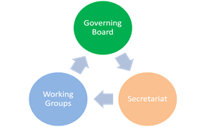
What is the LBBF?
In July 2007 the Liberian Better Business Forum was launched and officially endorsed by Liberia’s government and private sector as a new mechanism to facilitate dialogue on investment climate issues.
The forum brings together the GOL and the private sector to engage in constructive dialogue on identifying, prioritizing, and resolving key constraints to private sector development.
The structure of the forum includes 3 bodies and the public and private sector share equal representation on the Governing Board and Working Groups.

Slide 5
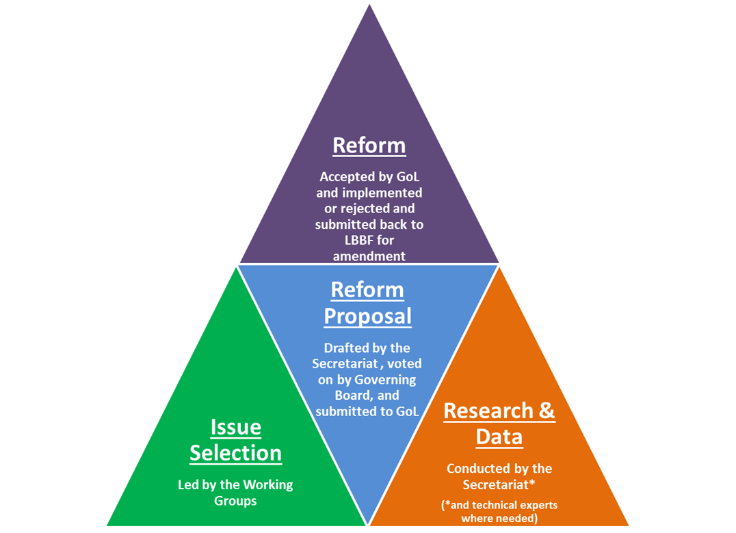
Working Groups
There are currently five LBBF Working Groups based on the business constraints prioritized by the forum’s membership.
Corruption
Tax Rates & Procedures
Access to Finance
Access to Electricity
Customs Rates & Procedures

Slide 6
Challenges
Sustainability of reforms already enacted in addition to monitoring.
Capacity of all stakeholders to advocate for and research reforms
Ensuring budgetary support from both the Government and Private Sector once transition has been implemented.
Capacity building of the forum’s Secretariat post-transition
Ensuring GOL and Private Sector stays engaged and motivated to pass reforms based on recommendations from the forum post-transition
Specifically once a new administration has taken over in 2017

Slide 7
On the Road to Recovery !!

